Slide 1
Module 7
Describing Geographic Entities
RDA Training
University of Nevada, Las Vegas
May 2013

Slide 2
Please log in to RDA
Please feel free to sign up later for a month’s free access so you can practice (see handout)
Notes:
From now on, as I show slides of RDA, please feel free to go ahead and look yourself in the Toolkit.

Slide 3
Identifying Places: MARC Coding
Places are currently described in the MARC authority format.
RDA records identified by “z” in 008/10 (“Rules”) and $e rda in 040

Slide 4
Identifying Places: RDA Chapter 16
RDA Chapter 16 is not complete yet. Work needs to be done yet, especially on non-jurisdictional place names.
Place names are used to represent the name of the government with jurisdiction over the area (see 11.2.2.5.4). Chapter 16 contains enough information to describe these places.
Notes:
READ Together 11.2.2.5.4 exception for governments. Then turn to Chapter 16

Slide 5
Identifying Places: RDA Chapter 16
Non-jurisdictional places (e.g. lakes, mountains) are not covered in this module. They continue to be established and described following subject cataloging practice (SACO).
For decisions about “ambiguous” entities (whether they’re a subject or a name), see
  http://www.loc.gov/aba/pcc/saco/alpha405.html
Notes:
READ Together 11.2.2.5.4 exception for governments.
Look at http://www.loc.gov/aba/pcc/saco/alpha405.html. NOTE: in the list, all entities tagged with 151 are considered place names; whether they’re established following RDA Chapter 16 or SHM is also listed.
Then turn to Chapter 16

Slide 6
Identifying Places: Core Elements
No core elements have been identified yet in RDA. However, jurisdictional places are corporate bodies. The following slide shows the core elements for corporate bodies that are appropriate for places.

Slide 7
Identifying Corporate Bodies (Jurisdictions) : Core Elements
Preferred name for the jurisdiction
Date associated with the jurisdiction
Identifier
Core if needed to distinguish
Other designation associated with the jurisdiction
Notes:
Open to RDA 8.3, looking for core elements for the corporate body. CLICK THROUGH as people find them.

Slide 8
Identifying Places: Transcription and Capitalization
Nothing has been specified in Chapter 12. However, place names that are jurisdictions follow the guidelines for corporate bodies:
  8.5.1. Capitalization: Follow Appendix A.2; see also A.13
  8.5.4. Diacritical marks: record them as they appear; add them if it is certain that they are integral to the name but were omitted in the source
  8.5.5. Retain hyphens if used by the entity
  8.4. Language and script. NACO policy = Romanize vernacular scripts.
Notes:
READ TOGETHER A.13. Note that A.13 is talking about capitalization in transcription. These are not necessarily the preferred names of these entities (e.g. New York, not New York City).

Slide 9
RDA 8.12. Source Consulted
Again, nothing in Chapter 12. Follow the same practice as for other corporate bodies (8.12)
  Record in 670 field, or 3XX $u/$v
  Always include one 670 for the work being cataloged
  Others included if needed to justify information in the description
  Suggested format:
    670 $a Title proper, date: $b citation (data)
Notes:
Everyone go to RDA 8.12.

Slide 10
670 field examples
  670 $a Joseph Guarnerius del Gesù, 1995: $b title page (Comune di Cremona)
670 $a Wikipedia, October 27, 2008 $b (Cremona, city and commune in northern Italy, in Lombardy; capital of the province of Cremona; noted for musical history, including luthier families such as Guarneri, Stradivari, Amati, 45°08'N 10°02'E)
670 $a Rand McNally commercial atlas, 1982 $b (American Fork, Utah County)
670 $a GeoNames, 16 October 2012 $b (Cremona, populated place in Lombardia, Italy, 45°07’00”N 010°02’00”E)
Notes:
Explain the OCLC 670.
There are lots of ways to form these. The point is, record information justifying what you’ve included in other elements in the description.

Slide 11
Identifying Places: Sources
Where can we get information about places?
  16.1.1: Take the name or names of the place from any source; take information on other identifying attributes from any source.
  In NACO practice, some required sources:
    geonames.usgs.gov (places worldwide)
    www.ordnancesurvey.co.uk (places in Great Britain)
  see also www.loc.gov/aba/pcc/saco/resources.html#GEOG

Slide 12
Identifying Places: Sources
Other sources to check
  The resource you are cataloging
  The LC/NACO Authority File (authorities.loc.gov)
  Your database (e.g. OCLC)
  Optional: Other useful sources
    Virtual International Authority File (http://viaf.org)
    Wikipedia (http://www.wikipedia.org/)
    Other sources such as encyclopedias and dictionaries

Slide 13
Attributes of Places:
Preferred Name
Preferred name is a core element for jurisdictions (corporate bodies)
Preferred name
  Chosen according to 16.2.2.3. Use:
    the form of the name in the language preferred by the agency preparing the data, if there is one in general use. For NACO catalogers, this is generally the form in GeoNames or GNIS.
    the form of the name in the official language of the jurisdiction in which the place is located.

Slide 14
Attributes of Places: Preferred Name (MARC)
Most RDA entity attributes have a discrete place in MARC to record them. Preferred name does not. It can only be recorded as part of the authorized access point for the place.
Record in the MARC authorities format 151 field (no indicators)
Record the preferred name in subfield $a.
NOTE: if the place name is used as the first part of the preferred name for a subordinate body, it is recorded in MARC 110, first indicator 1.
Notes:
LOOK AT MARC authority format 151 field.

Slide 15
Attributes of Places: Preferred Name (MARC examples)
    151 $a Beijing (China)
    151 $a New York (N.Y.)
    151 $a New York (State)
    151 $a Provo (Utah)
    151 $a France
    151 $a Greenwich Village (New York, N.Y.)
    151 $a Greenwood (Clearfield County, Pa. : Township)
    151 $a Greenwood (Crawford County, Ark.)
Notes:
LOOK AT MARC authority format 151 field.

Slide 16
Exercise
Go to geonames.usgs.gov
Under Search, choose “detailed search”
Under Name type search, choose “select all”
  Look up Turin, Italy
  Look up Orem, Utah
Notes:
The preferred name will normally be the GeoNames “conventional” form; if no conventional, use an English form; if no English form, use “approved” form.
Turin: notice we get both the city and the province.
Click through to the city. A small window opens up with information about Turin. This window gives the name of the region it’s in (Piemonte) and the fact that “Turin” is the English language form.
Record the conventional form in a 151 field
Record the Source Consulted element in 670 (“Geonames, date ... ) Be sure to include the preferred name, any alternate names, longitude and latitude, information about the fact that it’s in Piemonte)
Do the same for Orem, but this is in the GNIS database (U.S. names)
Record all the information from Wikipedia, too.

Slide 17
Exercise
Look up these same two places in Wikipedia
Look for these cities’ official websites
Record on worksheets the preferred name (151) and sources consulted (670)
For now, just record the name, no additions.

Slide 18
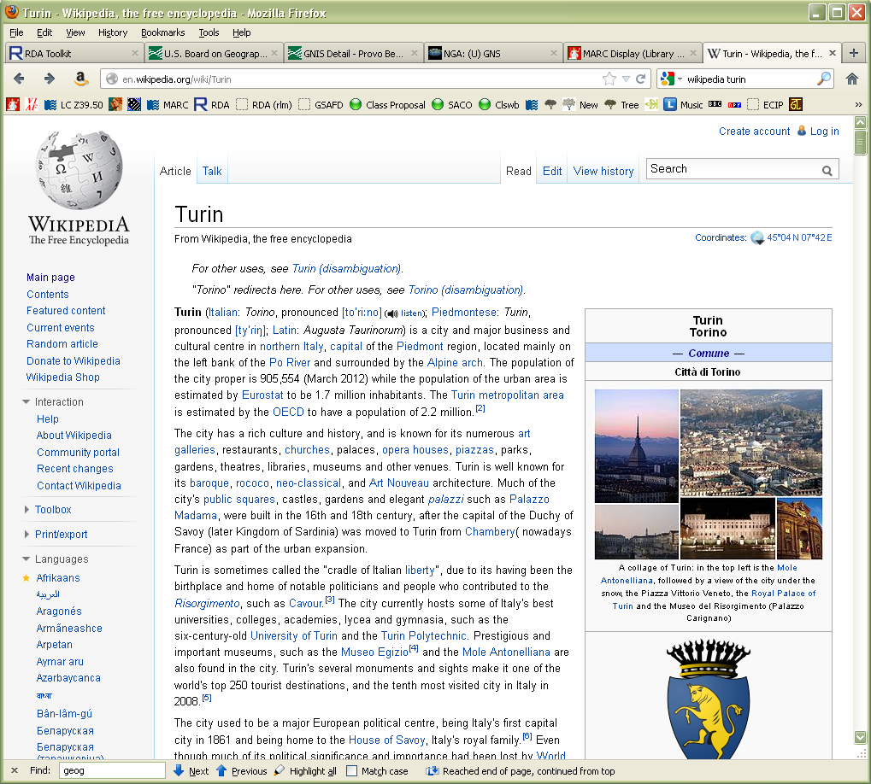
Notes:
Wikipedia as of 20 October 2012; we also learn more about the history of the city further down.

Slide 19
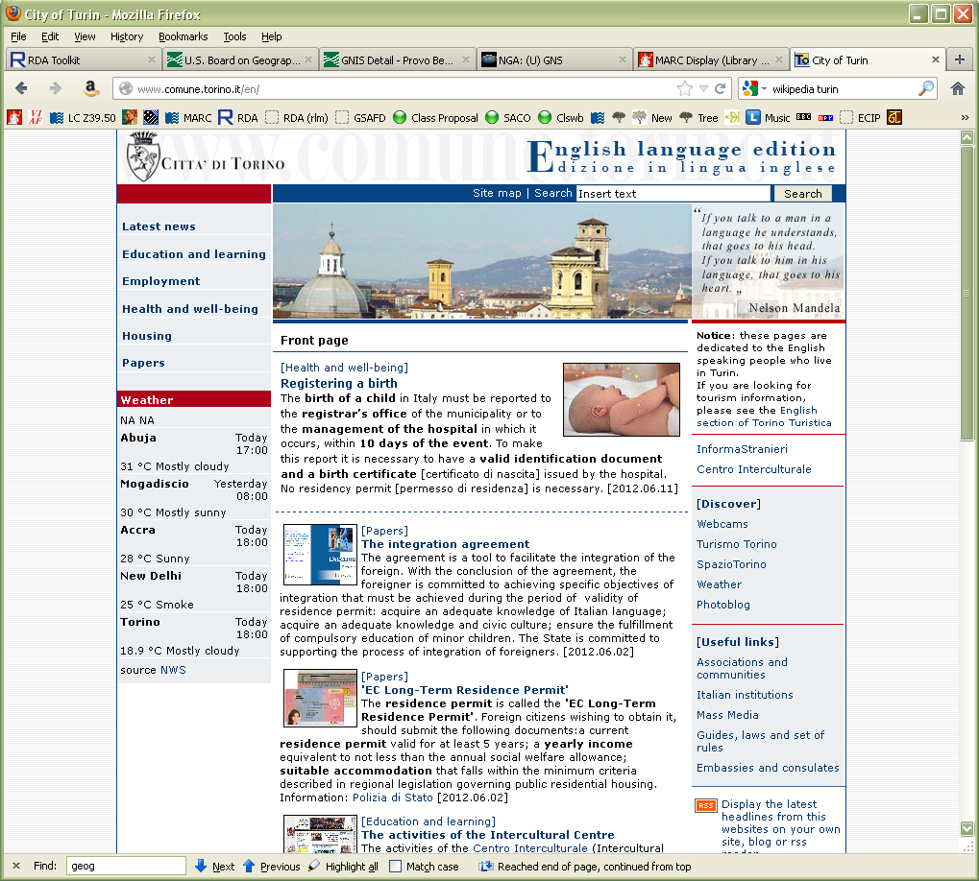
Notes:
The English version of the City’s official website as of 20 October 2012. Note two different presentations of the name (header and banner). If we were ambitious we could look at all the versions of the website (Italian, French, Spanish, Arabic, Albanian, and Romanian) to find variant names in those languages.

Slide 20

Notes:
Orem’s website http://www.orem.org/ as of 20 October 2012. Note three different presentations of the name: Orem, City of Orem, Orem City (in the header)

Slide 21
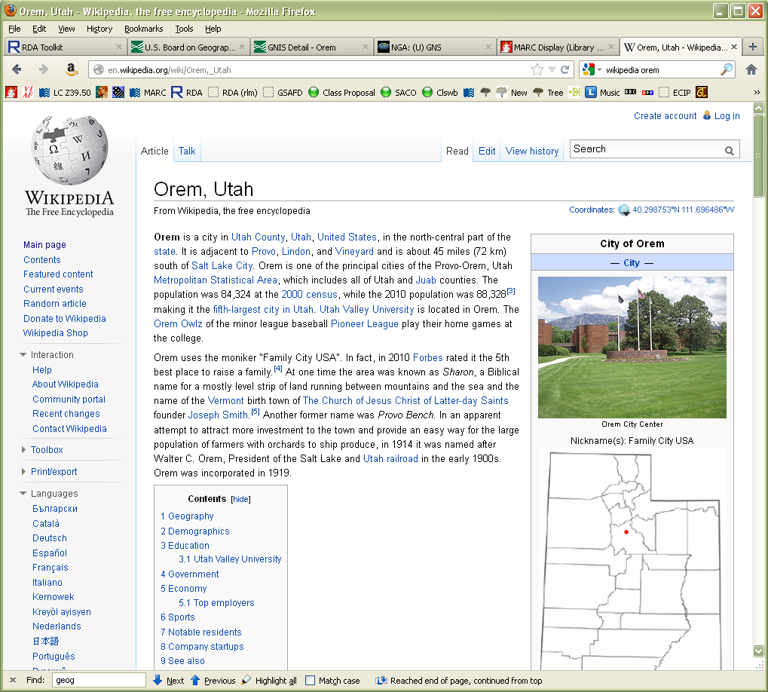
Notes:
Wikipedia article as of 20 October 2012. We also learn that the area was settled in 1877, and it used to be called “Sharon” and “Provo Bench”; the city was named Orem in 1914 (which, following the principles of corporate bodies, marks the beginning of the jurisdiction). Note: note clear whether “Sharon” and “Provo Bench” are variant names or earlier names. For this exercise, we’ll consider them variants.

Slide 22
Attributes of Places:
Recording the Preferred Name
16.2.2.4
  a. Record the commonly known form (for NACO, usually the GeoNames/GNIS conventional or preferred form)
    If the first part of the name is a term indicating a type of jurisdiction, omit the term unless the place is commonly listed under that part (16.2.2.8.1)
      Provo not City of Provo
      Massachusetts not Commonwealth of Massachusetts
      but District of Columbia not Columbia
Notes:
Look together at 16.2.2.4

Slide 23
Attributes of Places:
Recording the Preferred Name
16.2.2.4
  b. Add, in parentheses, the name of the larger place in which it is located.
    Use established forms of names in the parentheses. However, if the qualifying name to be used itself has a qualifier, remove the parentheses and separate the names with a comma; and delete qualifiers that are types of jurisdictions
      Pleasant View (Davis County, Utah)
        established form of larger place: Davis County (Utah)
      Moscow (Russia)
        established form of larger place: Russia (Federation)
      North-West Quadrant (Liberty, Butler County, Ohio)
        Established form of larger place: Liberty (Butler County, Ohio : Township)
Notes:
The North-West Quadrant example is a made up example, although there really is a North-West Quadrant of this township: http://www.liberty-township.com/Fire-EMS/Fire-Station-111-Apparatus-1820.html. Replace with a better example if found.

Slide 24
Attributes of Places:
Recording the Preferred Name
16.2.2.4
  b. Add, in parentheses, the name of the larger place in which it is located.
    Use the established form of the country’s name. However, abbreviate if the country appears in Appendix B.2 (16.2.2.11)
      Berlin (Germany)
      Christchurch (N.Z.)
      Tombouctou (Mali)
      Ho Chi Minh City (Vietnam)

Slide 25
Attributes of Places:
Recording the Preferred Name
16.2.2.4
  b. Add, in parentheses, the name of the larger place in which it is located.
    For places in Australia, Canada, United States, the former U.S.S.R., or the former Yugoslavia, add the state, province, etc. instead of the name of the country. Use the established form of the larger place, but abbreviate if the larger place appears in Appendix B.2 (16.2.2.9.2)
      Sydney (N.S.W.)
      Saint Petersburg (Pa.)
      Toronto (Ont.)

Slide 26
Attributes of Places:
Recording the Preferred Name
16.2.2.4
  b. Add, in parentheses, the name of the larger place in which it is located.
    For places in the England, Ireland, Northern Ireland, Scotland, and Wales, add the country as appropriate (16.2.2.10.1)
      York (England)
      Kildonan (Scotland)
      Llanfair Pwllgwyngyll (Wales)

Slide 27
Attributes of Places:
Recording the Preferred Name
16.2.2.4
  b. Add, in parentheses, the name of the larger place in which it is located.
    For places with the same name, either use an expanded form of the name or record a smaller place (than that normally used) as the qualifier (16.2.2.12)
      Ashton under Hill (England)
      Ashton-under-Lyne (England)
      Pleasant View (Davis County, Utah)
      Pleasant View (Utah County, Utah)
      Pleasant View (Weber County, Utah)
Notes:
NOTE!! Under NACO policy, if a conflict is discovered, it MUST be resolved even if the other conflicting place hasn’t been established. This is different from NACO policy for other entities.

Slide 28
Attributes of Places:
Recording the Preferred Name
16.2.2.4
  b. Add, in parentheses, the name of the larger place in which it is located.
    For places within cities, add the name of the city (16.2.2.13)
      Soho (London, England)
      Hollywood (Los Angeles, Calif.)
      Georgetown (Washington, D.C.)
      Rive gauche (Paris, France)
      Cabbagetown (Toronto, Ont.)

Slide 29
Attributes of Places: Variant Name (MARC)
Like the Preferred Name element, the Variant Name element (RDA 9.2.3) does not have a discrete place in MARC. It can only be recorded as part of the variant access point for the place.
Record in the MARC authorities format 451 field, no indicators; or other MARC field as appropriate.
Record the variant name in subfield $a.
Notes:
LOOK AT MARC authority format 451 field.

Slide 30
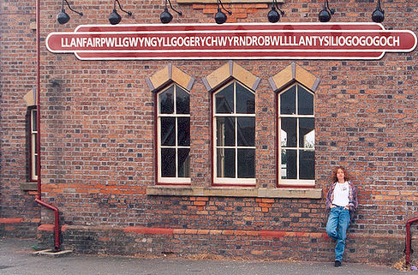
Variant of Llanfair Pwllgwyngyll (Wales)
Notes:
The name from Wales is not actually the preferred name for this place, but I couldn’t resist! The name translates as "The church of St. Mary in the hollow of white hazel trees near the rapid whirlpool by St. Tysilio's of the red cave"
Llanfairpwllgwyngyllgogerychwyrndrobwllllantysiliogogogoch (Wales)

Slide 31
Attributes of Place: Variant Name (MARC examples)
      151 $a Llanfair Pwllgwyngyll (Wales)
      451 $a Llanfairpwllgwyngyllgogerychwyrndrobwllllantysiliogogogoch (Wales)
      151 $a Cabbagetown (Toronto, Ont.)
      410 2 $a Toronto (Ont.). $b Cabbagetown
      151 $a Tombouctou (Mali)
      451 $a Timbuktu (Mali)
      451 $a Tumbuktū (Mali)
Notes:
Note: for city sections record a variant as a subordinate body to the city.
Record any variants for Orem or Turin in 451

Slide 32
Attributes of Places: Name
16.2.2.7. Change of name
  Jurisdictions are corporate bodies. Therefore, when they change names they follow the same guidelines as for other corporate bodies: a new corporate body is considered to be formed, requiring a new description.
    Previous description 151 $a Saigon (Vietnam)
    New description 151 $a Ho Chi Minh City (Vietnam)
    Previous description 151 $a Belgian Congo
    New description 151 $a Congo (Democratic Republic)

Slide 33
Attributes of Places: Place
No specific instructions in Chapter 16, but for jurisdictions we can follow the guidelines for corporate bodies (11.3)
Can be useful to record larger places the jurisdiction is a part of
The element is recorded in MARC 370 field

Slide 34
Recording the Place Attribute
Place is recorded in MARC 370
  Associated country $c
  Other associated place $f

Slide 35
Recording the Place Attribute
The form of the place name is governed by RDA Chapter 16.
Authorized access points for jurisdictional place names are generally formed as in AACR2, e.g. “Paris (France)” However:
16.2.2.4. “If the place name is being used to record ... a place associated with a corporate body ... precede the name of the larger place by a comma.” -- e.g. “Paris, France”
Notes:
Current practice—may change this year.

Slide 36
Recording the Place Attribute
Abbreviations. 11.3.1.3 says: “Abbreviate the names of countries, states, provinces, territories, etc., as instructed in appendix B (B.11), as applicable.”
So when recording this attribute for a place, use, e.g., “U.S.”, not “United States.”
Notes:
LOOK at B.11

Slide 37
Recording the Place Attribute: LCSH
Place names can also be drawn from LCSH. If so, record them exactly as found and include $2 lcsh.
  370 $f Cache Valley (Utah and Idaho) $2 lcsh
  370 $f Tahoe, Lake (Calif. and Nev.) $2 lcsh
  Do not mix NACO AF terms and LCSH terms in the same 370 field. If you need to use both, record them in separate fields.
Notes:
Note that 370 can be repeated, or alternately subfields can be repeated within a single 370.

Slide 38
Recording the Place Attribute
Record appropriate place attributes for Orem and Turin

Slide 39
Attributes of Places: Dates
No specific instructions in Chapter 16, but for jurisdictions we can follow the guidelines for corporate bodies (11.4)
We can record date of establishment (11.4.3) and date of termination (11.4.4)
Notes:
Everyone look at 11.4, where we learn how to record dates in RDA.

Slide 40
Attributes of Places: Dates
This element is recorded in MARC 046 in the format YYYYMMDD or YYYY-MM or YYYY
Date of establishment is recorded in $s; date of termination in subfield $t
Notes:
GO TO MARC 046 field; record dates for Orem and Turin (if you decide they’re known)

Slide 41
Attributes of Places: Other Designation
No specific instructions in Chapter 16, but for jurisdictions we can follow the guidelines for corporate bodies (11.7)
Can record the type of jurisdiction or other types of information
Record this element in a MARC authorities 368 field, subfield $b or (sometimes) $c.
Notes:
Go to 11.7.

Slide 42
Attributes of Places: Other Designation
151 $a Rome (Italy)
368 $b City
151 $a France
368 $b Country
151 $a Congo (Democratic Republic)
368 $b Country $c Democratic Republic
151 $a Balrothery (Ireland)
368 $b Village
Notes:
Exercise: record other designation for Turin and Orem

Slide 43
Attributes of Places:
Corporate History
No specific instructions in Chapter 16, but for jurisdictions we can follow the guidelines for corporate bodies (11.11)
11.11. Information pertaining to the history and nature of the jurisdiction.
Record a brief statement about the place. This is entirely free text, in your own words, based on the sources you have consulted.
Intended to be read by the public.
Notes:
Look at 11.11 together.

Slide 44
Attributes of Places:
Corporate History
Record this element in a MARC authority 678 field, first indicator “1”.
    678 1 $a Barothery is a village in Fingal, Ireland founded as early as the thirteenth century.
    678 1 $a Ho Chi Minh City is the largest city in Vietnam. Formerly named Saigon, the name was changed in 1975 at the end of the Vietnam War.
Notes:
EXERCISE: Record the corporate history element for Orem and Turin.

Slide 45
Attributes of Places:
Identifier
A character string uniquely associated with a place or an authority record
LCCN associated with an authority record is an identifier, recorded in 010
The element is core for other entities (no core defined for places), but it is usually added to record automatically

Slide 46
Constructing the Authorized Access Point for a Place (RDA 16.4)
Authorized Access Point is constructed using elements you have already recorded in the description
Record in 151
Begin with the preferred name
Make required additions
Consult 11.13 for jurisdictional place names (no guidelines yet in Chapter 16)

Slide 47
Constructing the Variant Access Point for a Place (RDA 16.4)
Variant Access Point is constructed using elements you have already recorded in the description
Record in 451
Begin with a variant name
Make required additions
Consult 11.13 for jurisdictional place names (no guidelines yet in Chapter 16)
Notes:
CONSTRUCT VARIANT ACCESS POINTS for Orem and Turin

Slide 48
Reminder: Source Consulted
RDA 8.12.1.3. Cite sources used to determine a preferred or variant name, followed by a brief statement of the information found. Identify the specific location within the source where the information was found.
RDA examples reflect NACO practice. Sources consulted are recorded in MARC 670 fields.
Notes:
Record the sources consulted on your worksheet (go back to the TP slide and the Wikipedia slide).
Turin—Slides 18-19
Orem—Slides 20-21

Slide 49
Related Jurisdictions (i.e., Corporate Bodies) (RDA 32)
Related jurisdictional places are recorded in 551 fields, and may include a relationship indicator in subfield $i (from RDA Appendix K), with $w r, or may use MARC $w coding.
    151 $a Ho Chi Minh City (Vietnam)
    551 $w r $i Predecessor: $a Saigon (Vietnam)
    or
    551 $w a $a Saigon (Vietnam)

Slide 50
RDA authority record
040 $a UPB $b eng $erda $c UPB
046 $s -0027~ $2 edtf
151 $a Turin (Italy)
368 $b City $b Comune
370 $f Piedmont, Italy $c Italy
451 $a Torino (Italy)
451 $a Città di Torino (Italy)
451 $a Augusta Taurinorum (Italy)
451 $a Julia Augusta Taurinorum (Italy)
451 $a Taurasia (Italy)
451 $a Castra Taurinorum (Italy)
670 $a [work being cataloged]
670 $a GeoNames, 20 October 2012 $b (Conventional name: Turin; in Piemonte, Italy; approved name: Torino; variant names: Augusta Taurinorum, Julia Augusta Taurinorum, Taurasia, 45°03’00”N, 007°40’00" E)
670 $a Wikipedia, 20 October 2012 $b (Turin; Torino; Città di Torino; Augusta Taurinorum; comune, city in Piedmont, Italy; 45° 03' N, 07° 42' E; home of the Shroud of Turin; first settlement a Roman military camp Castra Taurinorum, probably 28 BC)
670 $a Città di Torino English language edition, via WWW 20 October 2012 $b (Turin)
678 1 $a Turin (or Torino) is a city in Piedmont, Italy. It was first settled as a Roman military camp in the first century B.C. and is the home of the Shroud of Turin.
Notes:
Note very little is core or required in an RDA record. Institutions may declare other elements to be core. For example, the first source consulted (670) is core for PCC. (Language of cataloging is marked in the index as core but not in the rules themselves)
This record had a few more sources than you had, including one that has another variant form of the name.

Slide 51
RDA authority record
040 $a UPB $b eng $erda $c UPB
046 $s 1914
151 $a Orem (Utah)
368 $b City
370 $f Utah County, Utah $f Utah $c U.S.
451 $a City of Orem (Utah)
451 $a Orem City (Utah)
451 $a Sharon (Utah)
451 $a Provo Bench (Utah)
670 $a [work being cataloged]
670 $a GNIS, 20 October 2012 $b (Orem, populated place, Utah County, Utah, U.S., 40°17’49”N, 111°41’41”W)
670 $a Wikipedia, 20 October 2012 $b (Orem, Utah; City of Orem; in Utah County, Utah, United States; area settled in 1877 but named Orem in 1914; also known as Provo Bench, Sharon)
670 $a City of Orem, via WWW, 20 October 2012 $b (Orem, City of Orem, Orem City)
678 1 $a Orem is a city in Utah County, Utah founded in 1914, but first settled in 1877.
Notes:
Note very little is core or required in an RDA record. Institutions may declare other elements to be core. For example, the first source consulted (670) is core for PCC. (Language of cataloging is marked in the index as core but not in the rules themselves)
This record had a few more sources than you had, including one that has another variant form of the name.

Slide 52
Exercises
Using your worksheet, finish the descriptions of Turin and Orem
Create descriptions for other places associated with books you have brought
We can do some of these together in the LC/NACO Authority File

Slide 53
Module 7
Describing Geographic Entities
Questions?
RDA Training
University of Nevada, Las Vegas
May 2013

Slide 54
This Presentation is available at
http://net.lib.byu.edu/~catalog/people/rlm/RDALV201305/index.htm
For further information
contact Robert L. Maxwell
robert_maxwell@byu.edu

